Slide 1

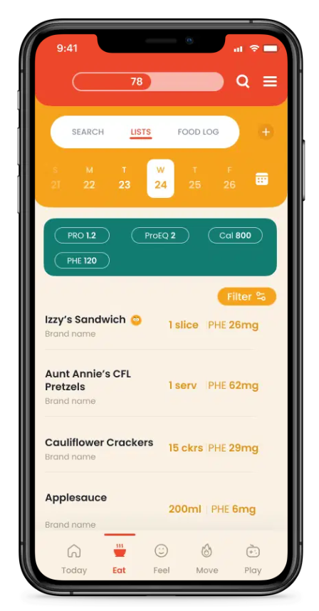
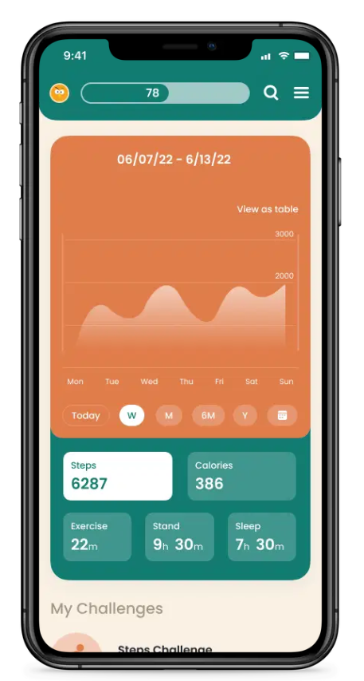
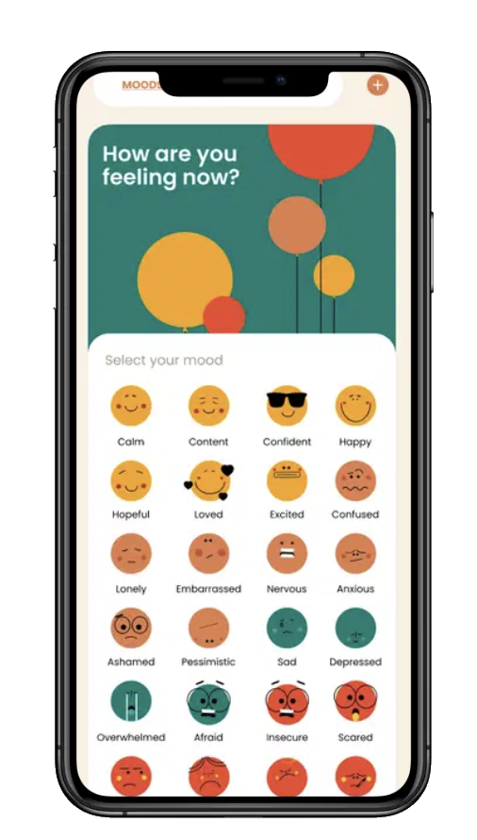
Flok –Diet Management Application
Business Need
PKU News, a non-profit focused on supporting the inherited metabolic disorder community, were looking to rebrand to Flok and release a new mobile application for diet management. They selected Affirma as their trusted software development partner.
Outcomes
Flok and Affirma release a React Native mobile application on Android and iOS with the following features
Diet Tracking - Track your diet, identify trends, and export records to share with your clinicians.
Search - take control of your low-protein diet amino acid data for more than 10,000 foods, recipes, stores and restaurants.
Mood Tracking - Track how you're feeling as you proceed throughout your day, week, or month.
Fitness Tracking - Fitness trackers these days give us so much information about our health, and the dynamics of metabolic disorders and exercise need more attention.
Chart & Labs - Track blood levels, height, weight, notes, and more.
flok.org Apple Store Google Play Store

Slide 2
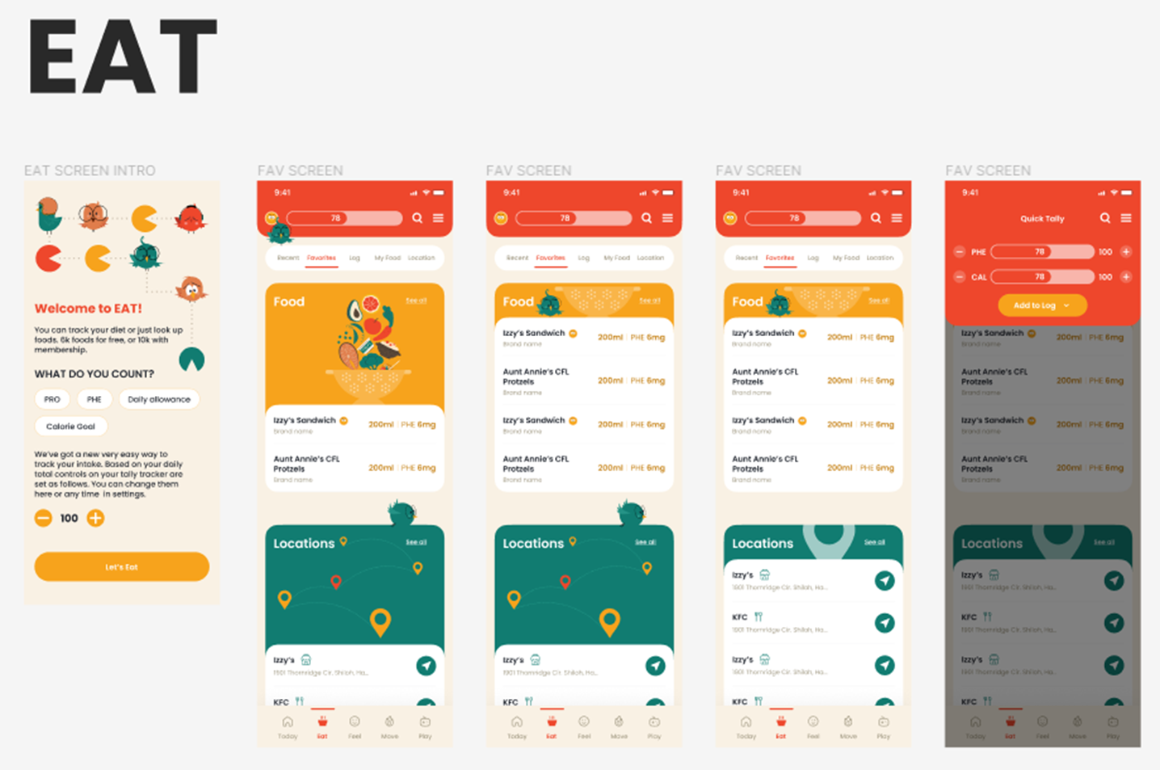

Slide 3
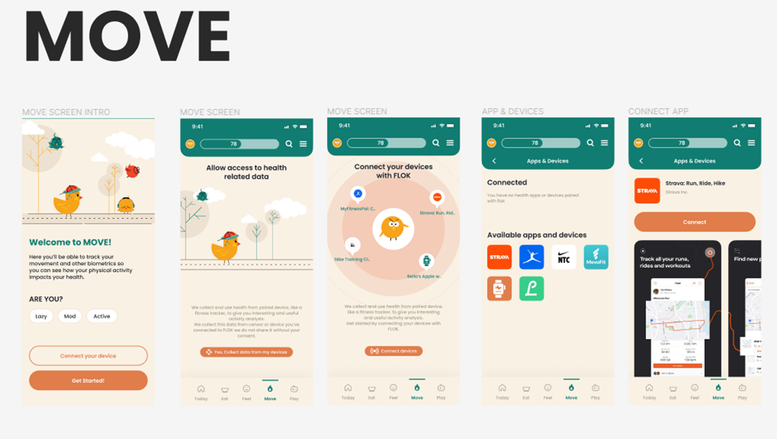

Slide 4
